Slide 1
Stock Price Prediction using Lasso Regression Algorithm
GUIDED BY:
Mrs. K. SARAVANASELVI, ME.,
HOD / IT
BHARATH NIKETAN ENGINEERING COLLEGE
TEAM MEMBERS:
S. VIVEKANANTHAN - (920120205018)
R. MUKESH - (920120205301)
P. PARTHIPAN - (920120205302)

Slide 2
Abstract
Accurate prediction of stock market returns is a very challenging task due to volatile and non-linear nature of the financial stock markets.
With the introduction of artificial intelligence and increased computational capabilities, programmed methods of prediction have proved to be more efficient in predicting stock prices.
The financial data: Open, High, Low and Close prices of stock are used for creating new variables which are used as inputs to the model.
The models are evaluated using standard strategic indicators: RMSE and MAPE. The low values of these two indicators show that the models are efficient in predicting stock closing price.
The system is developed the machine learning algorithm such as lasso regression and support vector regression.

Slide 3
Objectives
The main objective of our project is,
To forecast or to predict the stock price effectively.
To implement the different machine learning algorithms for better performance.
To enhance the overall performance for classification algorithms.

Slide 4
Introduction
Stock market is characterized as dynamic, unpredictable and non-linear in nature. Predicting stock prices is a challenging task as it depends on various factors including but not limited to political conditions, global economy, company’s financial reports and performance etc.
Data mining is the computing process of discovering patterns in large datasets. It involving methods at the intersection of machine learning, statistics and database systems.
Prediction is important in the sense that it provides concrete data for investment decisions. Using machine learning algorithms, to predict the stock.
To deal with this variety of data efficient model is needed that can identify the hidden patterns and complex relations in this large data set. Machine learning techniques in this area have proved to improve efficiencies by 60-86 percent as compared to the past methods

Slide 5
Existing system
In existing system, accurate prediction of a stock price is a challenging task due to the complexity, chaos, and non-linearity nature of financial systems.
In this brief, we proposed a multi-indicator feature selection method for stock price prediction based on Pearson Correlation coefficient (PCC) and Broad Learning System (BLS), Named the PCC-BLS framework.
In this work, Artificial Neural Network and Random Forest techniques have been utilized for predicting the next day closing price for five companies belonging to different sectors of operation.
The financial data: Open, High, Low and Close prices of stock are used for creating new variables which are used as inputs to the model.
The models are evaluated using standard strategic indicators: RMSE and MAPE. The low values of these two indicators show that the models are efficient in predicting stock closing price.

Slide 6
Disadvantages
Doesn’t Efficient for handling large volume of data.
Incorrect Classification Results.
Less Prediction Accuracy

Slide 7
Proposed system
In this system, the stock price dataset was taken as input from the dataset repository. Then, we have to implement the data pre-processing step. In this step, we have to handle the missing values for avoid wrong prediction.
After that, we have to implement the feature selection for selecting the best features from our dataset by using Pearson coefficient.
Then, we have to split the data into test and train. In this step, test is used for predict the model and train is used for evaluate the model.
We have to implement the machine learning regression algorithms such as support vector regression and linear regression .Finally, the experimental results shows that the performance metrics such as MAE, MSE, RMSE and predict or forecast the stock price based on input attributes.

Slide 8
Advantages
Time consumption is low.
The result or prediction is effective.
The data is implemented with removing the unwanted data.

Slide 9

Flow diagram
Handling missing value
Input data
Preprocessing
Drop Unwanted Column
Stock Dataset
Test
Data Splitting
Train
Feature Selection
Pearson Correlation Coefficient
Existing System
Support Vector Regression
Proposed System
Classification
Lasso Regression
Performance metrics
MAE
MSE
Predict Stock Price
RMSE
Visualization

Slide 10
Modules
Input data
Preprocessing
Feature Selection
Data splitting
Classification
Prediction
Result Generation

Slide 11
Modules description

Slide 12
Data selection
The data selection is the process of selecting the data for predicting the stock.
The dataset was collected from dataset repository like UCI.
The dataset is in the format like ‘.csv’
In this system, the time series dataset is used for predicting the stock.
The dataset which contains the information about the high, low, open and close price.
With the help of panda’s package, we can read or load our input dataset.

Slide 13
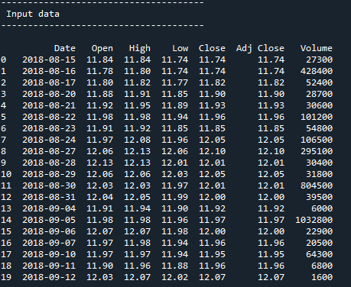
Data selection

Slide 14
Preprocessing
Data pre-processing is the process of removing the unwanted data from the dataset.
Data pre-processing allows for the removal of unwanted data with the use of data cleansing, this allows the user to have a dataset to contain more valuable information after the pre-processing stage for data manipulation later in the data mining process.
Missing data removal: In this process, the null values such as missing values and Nan values are replaced by 0.
Encoding Categorical data: That categorical data is defined as variables with a finite set of label values.

Slide 15
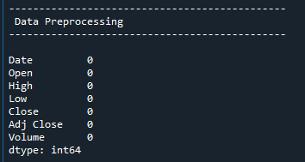
Preprocessing

Slide 16
Feature Selection
In this step, we can select the features from pre-processed data by using Pearson’s correlation.
One of the measures used for feature selection is dependency measures. Many dependency based methods have been proposed.
The main measure is Correlation based method. Pearson's Correlation method is used for finding the association between the continuous features and the class feature.
Features with high correlation are more linearly dependent and hence have almost the same effect on the dependent variable.
So, when two features have high correlation, we can drop one of the two features.

Slide 17
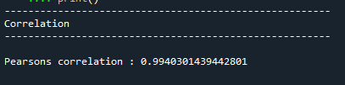
Feature Selection

Slide 18
Data splitting
Data splitting is the act of partitioning available data into two portions, usually for cross-validator purposes.
One Portion of the data is used to develop a predictive model and the other to evaluate the model's performance.
Separating data into training and testing sets is an important part of evaluating data mining models.
Typically, when you separate a data set into a training set and testing set, most of the data is used for training, and a smaller portion of the data is used for testing.

Slide 19
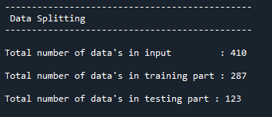
Data splitting

Slide 20
Regression
In our process, we have to implement the two machine learning algorithm such as lasso regression and support vector regression.
Support Vector Regression is a supervised learning algorithm that is used to predict discrete values. Support Vector Regression uses the same principle as the SVMs.
The basic idea behind SVR is to find the best fit line. In SVR, the best fit line is the hyper plane that has the maximum number of points.
Lasso regression is a type of linear regression that uses shrinkage. Shrinkage is where data values are shrunk towards a central point, like the mean.
The lasso procedure encourages simple, sparse models (i.e. models with fewer parameters).

Slide 21
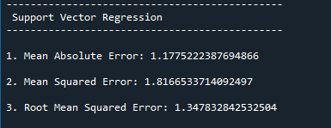
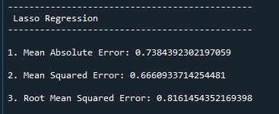
Regression

Slide 22
Performance analysis
The Final Result will get generated based on the overall classification and prediction. The performance of this proposed approach is evaluated using some measures like,
MAE: In statistics, the mean absolute error (MAE) is a way to measure the accuracy of a given model. It is calculated as,
Σ: A Greek symbol that means “sum”
yi: The observed value for the ith observation
xi: The predicted value for the ith observation
n: The total number of observations
MAE = (1/n) * Σ|y_{i} – x_{i}|

Slide 23
Performance analysis
MSE: The mean squared error (MSE) is a common way to measure the prediction accuracy of a model. It is calculated as:
Where:
Σ – a fancy symbol that means “sum”
n – sample size
actual – the actual data value
forecast – the predicted data value
MSE = (1/n) * Σ (actual – prediction) ²

Slide 24
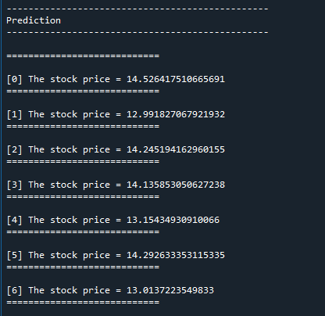
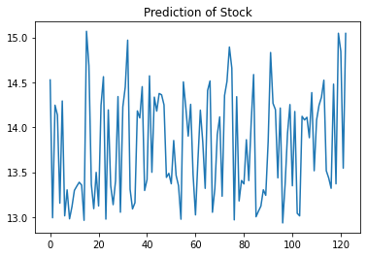
Prediction

Slide 25
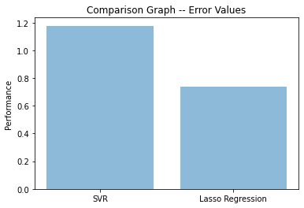
Prediction

Slide 26
System requirements
SOFTWARE REQUIREMENTS:
O/S : Windows 7.
Language : Python
Front End : Anaconda Navigator – Spyder
HARDWARE REQUIREMENTS:
System : Pentium IV 2.4 GHz
Hard Disk : 200 GB
Ram : 4GB

Slide 27
Literature survey
Title | Year | Author | Methology | Merits/demerits
Stock Closing Price Prediction using Machine Learning Techniques | 2020 | Mehar Vijha , Deeksha Chandolab, Vinay Anand Tikkiwalb, Arun Kumarc | With the introduction of artificial intelligence and increased computational capabilities, programmed methods of prediction have proved to be more efficient in predicting stock prices. In this work, Artificial Neural Network and Random Forest techniques have been utilized for predicting the next day closing price for five companies belonging to different sectors of operation. | • It prove to be highly useful for making stock market movements • To obtain higher accuracy in the predicted price value. • The noise in stock market data is usually quite high • Complexity is high

Slide 28
Literature survey
Title | Year | Author | Methology | Merits/demerits
Computational Intelligence Techniques Used for Stock Market Prediction: A Systematic Review | 2020 | S. Zavadzki; M. Kleina; F. Drozda; M. Marques | With the advancement of various computational techniques and the growing search for assertive predictive models, computational intelligence methods have attracted much attention. They are data-based methodologies and mainly include fuzzy logic, artificial neural networks and evolutionary computation. | • Hybrid articles were collected from four large databases. • It remove duplicated articles • Prediction of stock is improper • It occurred low accuracy

Slide 29
Literature survey
Title | Year | Author | Methology | Merits/demerits
Predicting Stock Market Trends Using Machine Learning and Deep Learning Algorithms Via Continuous and Binary Data; a Comparative Analysis | 2020 | MOJTABA NABIPOUR1, POOYAN NAYYERI, HAMED JABANI3 ,SHAHAB S | This study compares nine machine learning models (Decision Tree, Random Forest, Adaptive Boosting (Adaboost), eXtreme Gradient Boosting (XGBoost), Support Vector Classifier (SVC), Naïve Bayes, K-Nearest Neighbors (KNN), Logistic Regression and Artificial Neural Network (ANN)) | • On the contrary, constructing over-complex trees that cause over fitting. • Over-complex trees that cause over fitting is a typical disadvantage.

Slide 30
Literature survey
Title | Year | Author | Methology | Merits/demerits
An innovative neural network approach for stock market prediction | 2018 | Xiongwen Pang1 • Yanqiang Zhou1 • Pan Wang1 • Weiwei Lin2 • Victor Chang | This paper aims to develop an innovative neural network approach to achieve better stock market predictions. Data were obtained from the live stock market for real-time and off-line analysis and results of visualizations and analytics to demonstrate Internet of Multimedia of Things for stock analysis. | • The accuracy of two models is high. • Encoder to predict the stock market is low.

Slide 31
Literature survey
Title | Year | Author | Methology | Merits/demerits
Applications of deep learning in stock market prediction | 2020 | WeiweiJiang | Lately, deep learning models have been introduced as new frontiers for this topic and the rapid development is too fast to catch up. Hence, our motivation for this survey is to give a latest review of recent works on deep learning models for stock market prediction. | • Can achieve high classification rates. • Different sparse algorithm is analysed. • To easily reproduce the previous studies as baselines. • It didn’t implement the more than one algorithm

Slide 32
Conclusion
We conclude that, the stock price dataset was taken as input. The input dataset was mentioned in our research paper.
We are implemented the different machine algorithm such as support vector regression and lasso regression.
Then, we are predicted the house price and performance metrics such as MAE, MSE and RMSE.

Slide 33
Future enhancement
In future, will explore the application of more advanced deep learning methods and possible combinations of machine learning.
Future work should focus on predicting the movement of the stock market using structured data along with textual data from different resources like financial source and social media.
Moreover, to achieve better results in predicting the stock market, the text mining procedure should improve feature selection, feature representation.

Slide 34
References
[1] Masoud, Najeb MH. (2017) “The impact of stock market performance upon economic growth.” International Journal of Economics and
Financial Issues 3 (4) : 788–798.
[2] Murkute, Amod, and Tanuja Sarode. (2015) “Forecasting market price of stock using artificial neural network.” International Journal of
Computer Applications 124 (12) : 11-15.
[3] Hur, Jung, Manoj Raj, and Yohanes E. Riyanto. (2006) “Finance and trade: A cross-country empirical analysis on the impact of financial development and asset tangibility on international trade.” World Development 34 (10) : 1728-1741.

Slide 35
Thank You…

